Slide 1
差分方法与特征值计算讨论
2024.3.1

Slide 2
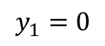
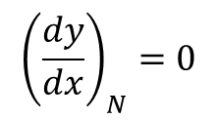
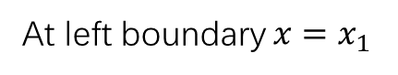
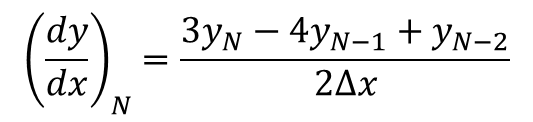
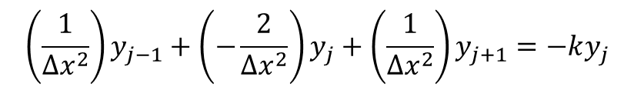
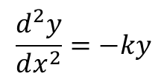
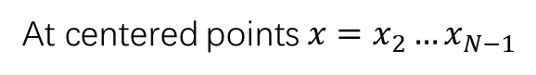
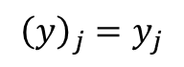
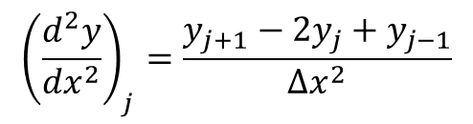
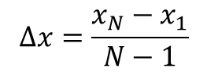
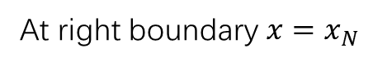
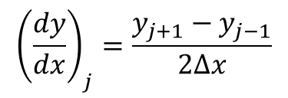
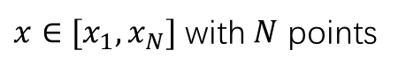
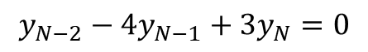
$$\frac{d^{2}y}{dx^{2}}=−ky$$
$$Δx=\frac{x_{N}−x_{1}}{N−1}$$
$x∈[x_{1},x_{N}]$ with $N$ points
$o\left(Δx^{2}\right)$ centered diff approx. (at centered grid points)
$o\left(Δx^{2}\right)$ backward diff approx. (at right boundary point $x_{N}$)
$${\left(y\right)}_{j}=y_{j}$$
$${\left(\frac{dy}{dx}\right)}_{j}=\frac{y_{j+1}−y_{j−1}}{2Δx}$$
$${\left(\frac{dy}{dx}\right)}_{N}=\frac{3y_{N}−4y_{N−1}+y_{N−2}}{2Δx}$$
$${\left(\frac{d^{2}y}{dx^{2}}\right)}_{j}=\frac{y_{j+1}−2y_{j}+y_{j−1}}{Δx^{2}}$$
At left boundary $x=x_{1}$
$$y_{1}=0$$
At right boundary $x=x_{N}$
$${\left(\frac{dy}{dx}\right)}_{N}=0$$
$$y_{N−2}−4y_{N−1}+3y_{N}=0$$
$$\left(\frac{1}{Δx^{2}}\right)y_{j−1}+\left(−\frac{2}{Δx^{2}}\right)y_{j}+\left(\frac{1}{Δx^{2}}\right)y_{j+1}=−ky_{j}$$
At centered points $x=x_{2}…x_{N−1}$

Slide 3
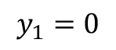
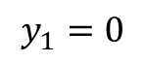
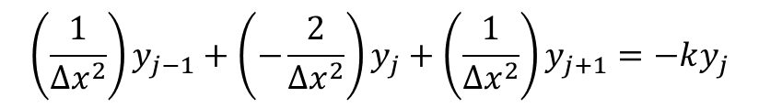
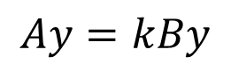
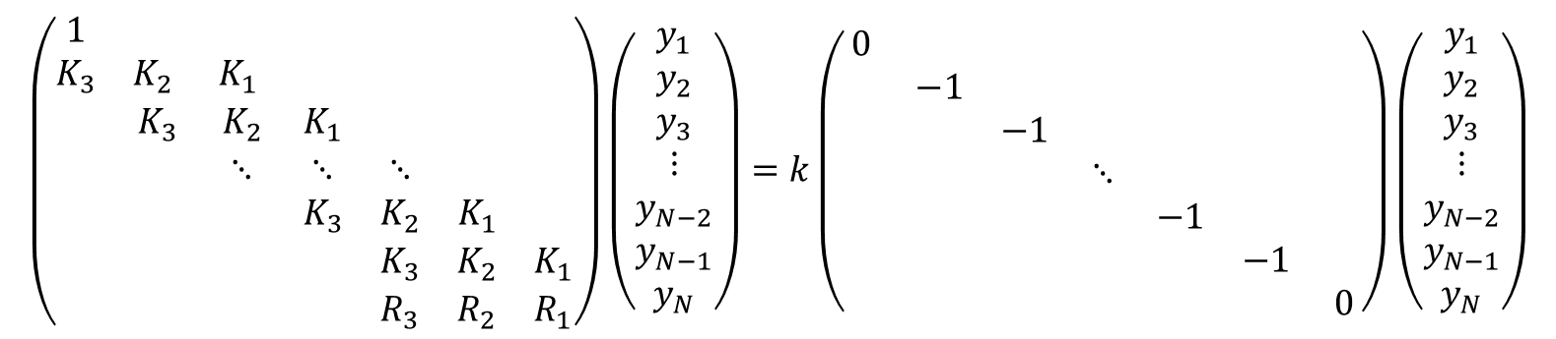
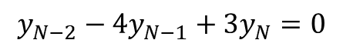
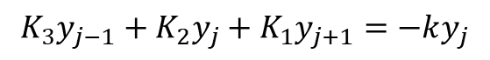
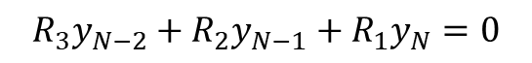
$$\frac{d^{2}y}{dx^{2}}=−ky$$
$$Δx=\frac{x_{N}−x_{1}}{N−1}$$
$x∈[x_{1},x_{N}]$ with $N$ points
$$y_{1}=0$$
$$y_{1}=0$$
$$\left(\frac{1}{Δx^{2}}\right)y_{j−1}+\left(−\frac{2}{Δx^{2}}\right)y_{j}+\left(\frac{1}{Δx^{2}}\right)y_{j+1}=−ky_{j}$$
$$K_{3}y_{j−1}+K_{2}y_{j}+K_{1}y_{j+1}=−ky_{j}$$
$$R_{3}y_{N−2}+R_{2}y_{N−1}+R_{1}y_{N}=0$$
$$y_{N−2}−4y_{N−1}+3y_{N}=0$$
Become generalized eigenvalue problem
$$\left(\begin{matrix}1 & & & & & & \\ K_{3} & K_{2} & K_{1} & & & & \\ & K_{3} & K_{2} & K_{1} & & & \\ & & ⋱ & ⋱ & ⋱ & & \\ & & & K_{3} & K_{2} & K_{1} & \\ & & & & K_{3} & K_{2} & K_{1} \\ & & & & R_{3} & R_{2} & R_{1}\end{matrix}\right)\left(\begin{aligned}y_{1} \\ y_{2} \\ y_{3} \\ ⋮ \\ y_{N−2} \\ y_{N−1} \\ y_{N}\end{aligned}\right)=k\left(\begin{matrix}0 & & & & & & \\ & −1 & & & & & \\ & & −1 & & & & \\ & & & ⋱ & & & \\ & & & & −1 & & \\ & & & & & −1 & \\ & & & & & & 0\end{matrix}\right)\left(\begin{aligned}y_{1} \\ y_{2} \\ y_{3} \\ ⋮ \\ y_{N−2} \\ y_{N−1} \\ y_{N}\end{aligned}\right)$$
$$Ay=kBy$$

Slide 4
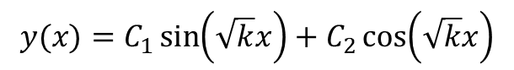
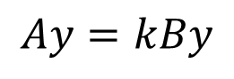
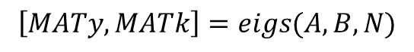
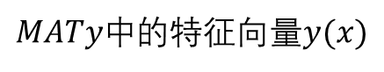
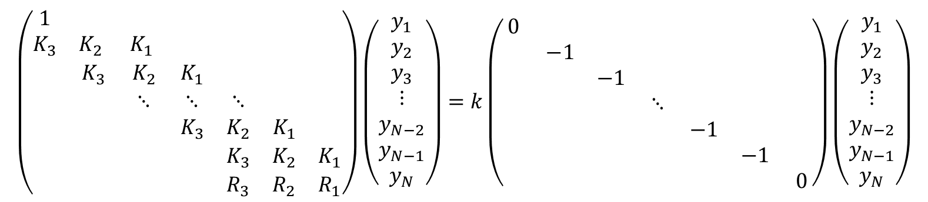
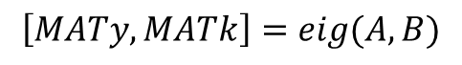
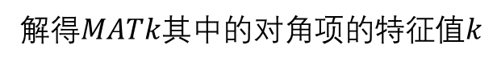
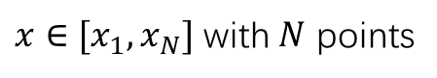
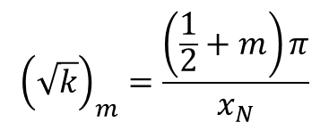
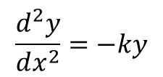
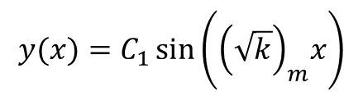
$$\frac{d^{2}y}{dx^{2}}=−ky$$
$x∈[x_{1},x_{N}]$ with $N$ points
Become generalized eigenvalue problem
$$\left(\begin{matrix}1 & & & & & & \\ K_{3} & K_{2} & K_{1} & & & & \\ & K_{3} & K_{2} & K_{1} & & & \\ & & ⋱ & ⋱ & ⋱ & & \\ & & & K_{3} & K_{2} & K_{1} & \\ & & & & K_{3} & K_{2} & K_{1} \\ & & & & R_{3} & R_{2} & R_{1}\end{matrix}\right)\left(\begin{aligned}y_{1} \\ y_{2} \\ y_{3} \\ ⋮ \\ y_{N−2} \\ y_{N−1} \\ y_{N}\end{aligned}\right)=k\left(\begin{matrix}0 & & & & & & \\ & −1 & & & & & \\ & & −1 & & & & \\ & & & ⋱ & & & \\ & & & & −1 & & \\ & & & & & −1 & \\ & & & & & & 0\end{matrix}\right)\left(\begin{aligned}y_{1} \\ y_{2} \\ y_{3} \\ ⋮ \\ y_{N−2} \\ y_{N−1} \\ y_{N}\end{aligned}\right)$$
$$Ay=kBy$$
$$\left[MATy,MATk\right]=eig(A,B)$$
通解为：
$$y(x)=C_{1}\sin\left(\sqrt{k}x\right)+C_{2}\cos\left(\sqrt{k}x\right)$$
$$\left[MATy,MATk\right]=eigs(A,B,N)$$
应用边界条件后：
理论解：
解得$MATk$其中的对角项的特征值$k$
$${\left(\sqrt{k}\right)}_{m}=\frac{\left(\frac{1}{2}+m\right)π}{x_{N}}$$
$$y(x)=C_{1}\sin\left({\left(\sqrt{k}\right)}_{m}x\right)$$
一一对应
$MATy中$的特征向量$y(x)$

Slide 5
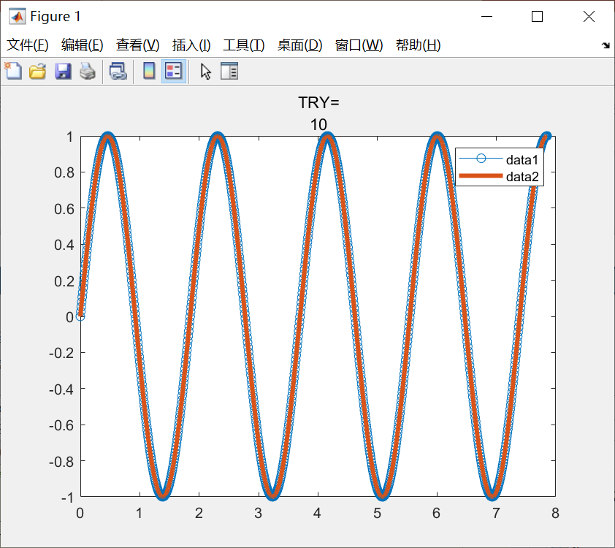
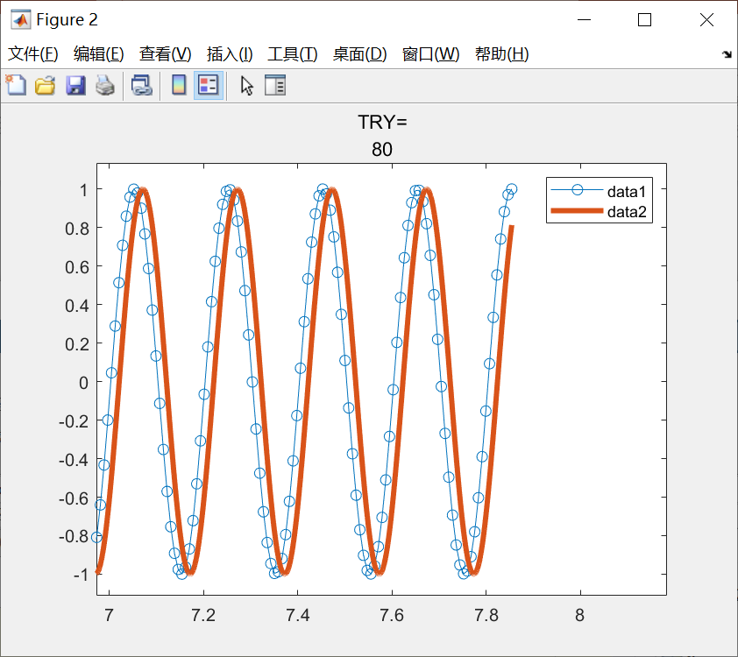
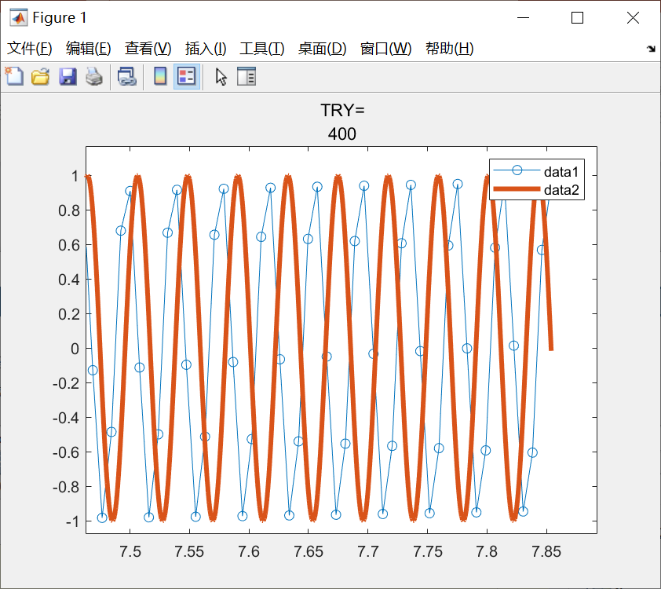
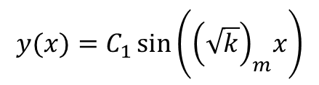
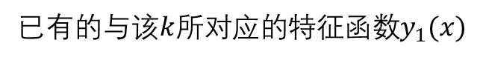
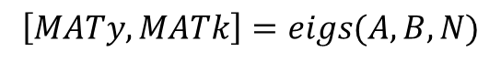
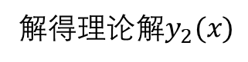
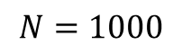
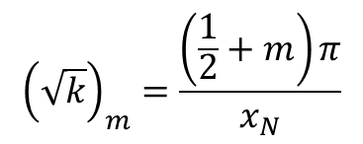
数值解得的特征向量与理论解相比较
$${\left(\sqrt{k}\right)}_{m}=\frac{\left(\frac{1}{2}+m\right)π}{x_{N}}$$
$$y(x)=C_{1}\sin\left({\left(\sqrt{k}\right)}_{m}x\right)$$
$$\left[MATy,MATk\right]=eigs(A,B,N)$$
比较方法：将解得的一组特征值中的其中一个$k$，当做理论解的$k$
已有的与该$k$所对应的特征函数$y_{1}(x)$
解得理论解$y_{2}(x)$
$$N=1000$$

Slide 6
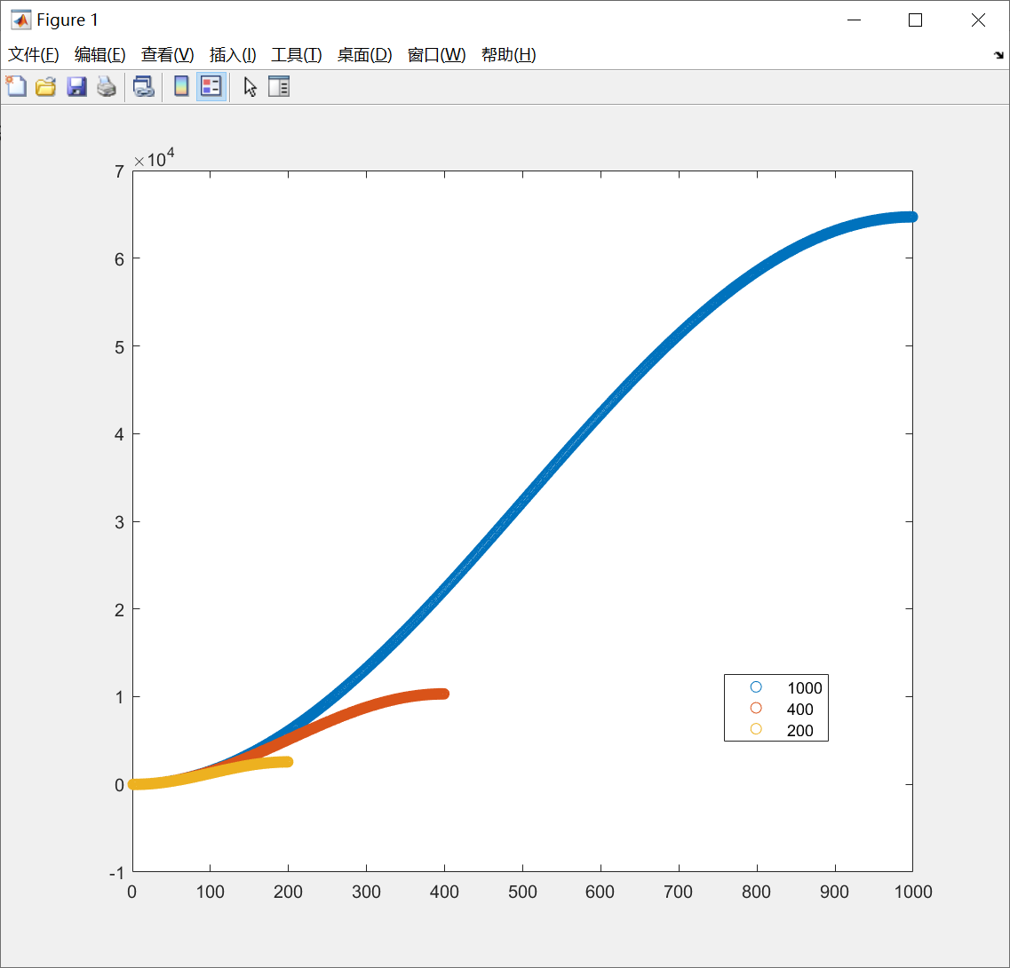
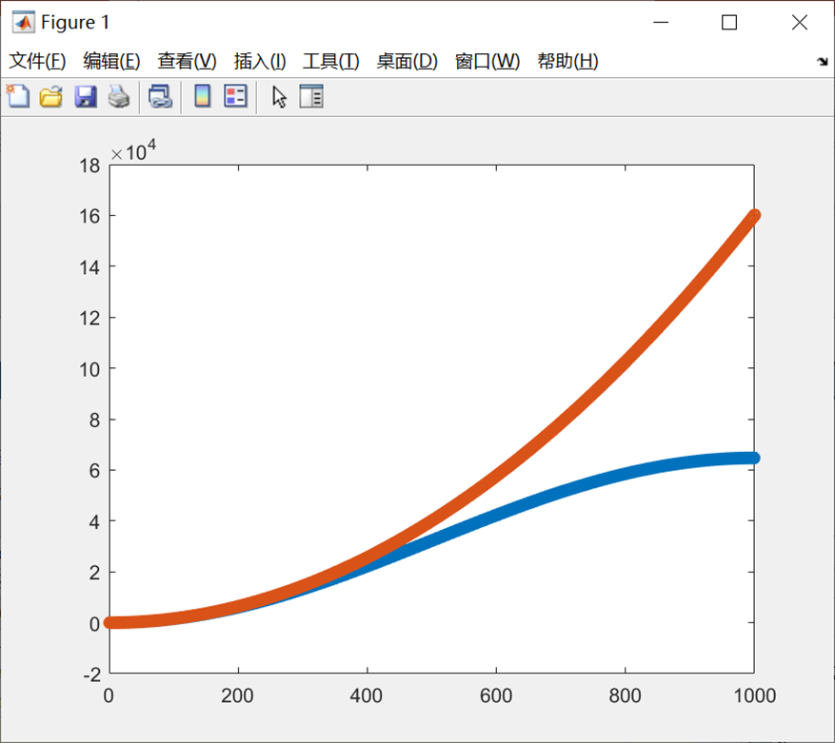
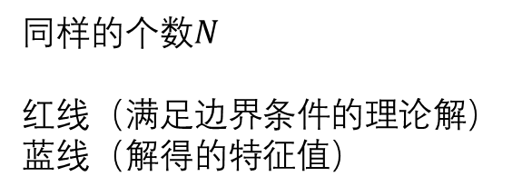

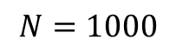
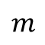
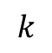
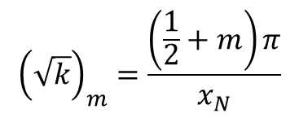
归咎为解得的特征值$k$不再满足
$${\left(\sqrt{k}\right)}_{m}=\frac{\left(\frac{1}{2}+m\right)π}{x_{N}}$$
$$N=1000$$
$$k$$
同样的个数$N$
红线（满足边界条件的理论解）
蓝线（解得的特征值）
$$m$$

Slide 7
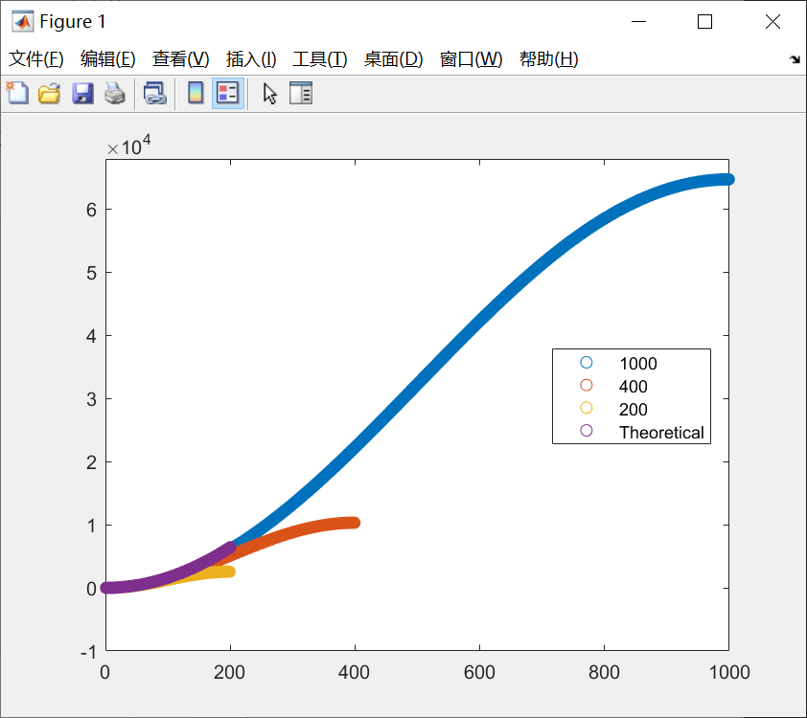


Slide 8





$$Ay=kBy$$
$$\left(A−kB\right)y=0$$
$$\det\left(A−kB\right)$$
INF?
$$Ay−kBy$$

Slide 9



降阶 格心 34

Slide 10




蓝点$N=100$
橙点$N=200$
黄点$N=600$

Slide 11




不降阶 格点 13

Slide 12

不降阶 格点 26

Slide 13


Slide 14





















浅水方程
$$f_{1}\left(h,u,v,\frac{dh}{dx},\frac{du}{dx}\right)=0$$
$$ψ={\left(\begin{aligned}h_{1} \\ u_{1} \\ v_{1} \\ {\left(\frac{du}{dx}\right)}_{1} \\ {\left(\frac{dv}{dx}\right)}_{1} \\ ⋮ \\ h_{N} \\ u_{N} \\ v_{N} \\ {\left(\frac{du}{dx}\right)}_{N} \\ {\left(\frac{dv}{dx}\right)}_{N}\end{aligned}\right)}^{}$$
差分方法与边界条件
$$f_{2}\left(h,u,\frac{dh}{dx},\frac{du}{dx},\frac{d^{2}u}{dx^{2}}\right)=0$$
$$f_{3}\left(h,v,\frac{dv}{dx},\frac{d^{2}v}{dx^{2}}\right)=0$$
对格子中心列方程：$5(N−1)$
$$…$$
$$x_{1}$$
$$x_{2}$$
$$x_{3}$$
$$x_{N−2}$$
$$x_{N−1}$$
$$x_{N}$$
左边界条件：$3$
格子中心的差分格式：
$${\left(\frac{dψ}{dA}\right)}_{j+\frac{1}{2}}=\frac{x_{j+1}−x_{j}}{Δx}$$
右边界条件：$2$
$$h=0$$
$$\frac{du}{dA}=0$$
$$u=0$$
$$ψ_{j+\frac{1}{2}}=\frac{ψ_{j+1}+ψ_{j}}{2}$$
$$v=0$$
$$\frac{dv}{dA}=0$$

Slide 15
Appendix

Slide 16

在这种情况下，改变网格的疏密也会影响相同格点区间下的$k−m$分布
无法验证网格无关性？

Slide 17



Slide 18





Slide 20









左端
$$y_{1}=0$$
降阶后的方程组边界条件设置的问题
右端
$${\left(\frac{dy}{dx}\right)}_{N}=0$$
浅水方程
$$f_{1}\left(h,u,v,\frac{dh}{dx},\frac{du}{dx}\right)=0$$
$$ψ={\left(\begin{aligned}h_{1} \\ u_{1} \\ v_{1} \\ {\left(\frac{du}{dx}\right)}_{1} \\ {\left(\frac{dv}{dx}\right)}_{1} \\ ⋮ \\ h_{N} \\ u_{N} \\ v_{N} \\ {\left(\frac{du}{dx}\right)}_{N} \\ {\left(\frac{dv}{dx}\right)}_{N}\end{aligned}\right)}^{}$$
离散后
$$f_{2}\left(h,u,\frac{dh}{dx},\frac{du}{dx},\frac{d^{2}u}{dx^{2}}\right)=0$$
$$Aψ=ωBψ$$
$$f_{3}\left(h,v,\frac{dv}{dx},\frac{d^{2}v}{dx^{2}}\right)=0$$
降阶后的$ψ$
$$ψ={\left(\begin{aligned}h_{1} \\ u_{1} \\ v_{1} \\ ⋮ \\ h_{N} \\ u_{N} \\ v_{N}\end{aligned}\right)}^{T}$$
半格点（网格中心）差分与格点上的差分

Slide 21







Non-dimensional depth-averaged governing eqns. --- Perturbation flow
$$H=1+H^{′}$$
$$U=1+U^{′}$$
$$V=0+V′$$
$$\frac{∂H^{′}}{∂T}+\frac{∂H^{′}}{∂A}+\frac{∂U′}{∂A}+\frac{1}{X_{2}}\frac{∂V′}{∂θ}+\frac{H′}{A}+\frac{U′}{A}=0$$
$$\frac{∂U′}{∂T}+C\frac{∂U′}{∂A}+\frac{1}{X_{2}}\frac{∂V′}{∂θ}+\frac{1}{X_{2}}2U^{′}\cos{α}=−\frac{1}{Fr^{2}}\frac{∂H^{′}}{∂A}+\frac{1}{Re^{∗}}\left[\frac{∂}{∂A}\left(\frac{∂U^{′}}{∂A}\right)+{\left(\frac{1}{X_{2}}\right)}^{2}\frac{∂}{∂θ}\left(\frac{∂U^{′}}{∂θ}\right)\right]+\frac{Γ}{Fr^{2}}\left(−U′+\frac{3}{2}H′\right)$$
$$\frac{∂V′}{∂T}+\frac{∂V′}{∂A}=−\frac{1}{Fr^{2}}\frac{1}{X_{2}}\frac{∂H′}{∂θ}+\frac{1}{Re^{∗}}\left[\frac{∂}{∂A}\left(\frac{∂V′}{∂A}\right)+{\left(\frac{1}{X_{2}}\right)}^{2}\frac{∂}{∂θ}\left(\frac{∂V′}{∂θ}\right)\right]+\frac{η}{Fr^{2}}\left(−V′+\frac{3}{2}H′\right)$$
$$Γ=\frac{γ}{{\left(1+γ\right)}^{2}}(\tan{ξ_{2}}−\tan{ξ_{1}})$$
$$Fr=\frac{\overline{u}}{{\left(gh\cos{α}\right)}^{\frac{1}{2}}}$$
$$Re^{∗}=\frac{\overline{u}\sqrt{h}}{ν}$$
$$ν=\frac{2}{9} \frac{ℒ}{β}\sqrt{g}\frac{\sin{α}}{\sqrt{\cos{α}}}\frac{\tan{ξ_{2}}−\tan{α}}{\tan{α}−\tan{ξ_{1}}}$$

Slide 22






$$\left(y_{I},y_{II},y_{III},y_{IV},y_{V}\right)=(α_{H},α_{U},α_{V},\frac{dα_{U}}{dA},\frac{dα_{V}}{dA})$$
List eqns. at half points
$$L_{1}y_{I_{i+1}}+L_{2}{y_{I}}_{i}+L_{3}{y_{II}}_{i+1}+L_{4}{y_{II}}_{i}+L_{5}{y_{III}}_{i+1}+L_{6}{y_{III}}_{i}+L_{7}{y_{IV}}_{i+1}+L_{8}{y_{IV}}_{i}=R_{1}{y_{I}}_{i+1}+R_{2}{y_{I}}_{i}$$
$$L_{9}{y_{I}}_{i+1}+L_{10}{y_{I}}_{i}+L_{11}{y_{II}}_{i+1}+L_{12}{y_{II}}_{i}+L_{13}{y_{III}}_{i+1}+L_{14}{y_{III}}_{i}+L_{15}{y_{IV}}_{i+1}+L_{16}{y_{IV}}_{i}=R_{3}{y_{II}}_{i+1}+R_{4}{y_{II}}_{i}$$
$$L_{17}{y_{I}}_{i+1}+L_{18}{y_{I}}_{i}+L_{19}{y_{III}}_{i+1}+L_{20}{y_{III}}_{i}+L_{21}{y_{V}}_{i+1}+L_{22}{y_{V}}_{i}=R_{5}{y_{III}}_{i+1}+R_{6}{y_{III}}_{i}$$
$$L_{23}{y_{II}}_{i+1}+L_{24}{y_{II}}_{i}+L_{25}{y_{IV}}_{i+1}+L_{26}{y_{IV}}_{i}=0$$
$$L_{27}{y_{III}}_{i+1}+L_{28}{y_{III}}_{i}+L_{29}{y_{V}}_{i+1}+L_{30}{y_{V}}_{i}=0$$
Left BCs
Right BCs
$${y_{I}}_{1}=0$$
$${y_{II}}_{1}=0$$
$${y_{IV}}_{N}=0$$
$${y_{III}}_{1}=0$$
$${y_{V}}_{N}=0$$

Slide 23

































List coeffs. at half points $i+\frac{1}{2}$
$$Γ=\frac{γ}{{\left(1+γ\right)}^{2}}(\tan{ζ_{2}}−\tan{ζ_{1}})$$
$$η=\tan{ζ_{1}}+\frac{\tan{ζ_{2}−\tan{ζ_{1}}}}{1+γ}$$
$$L_{1}=\frac{U_{s}}{h}+\frac{U_{s}}{2A}$$
$$L_{9}=\frac{1}{F^{2}h}−\frac{3}{2}\frac{Γ}{F^{2}}\frac{1}{2H_{s}}$$
$$L_{17}=i\frac{1}{F^{2}}\frac{k_{2}}{\cos{ζ}}\frac{1}{2A}$$
$$L_{2}=−\frac{U_{s}}{h}+\frac{U_{s}}{2A}$$
$$L_{10}=−\frac{1}{F^{2}h}−\frac{3}{2}\frac{Γ}{F^{2}}\frac{1}{2H_{s}}$$
$$L_{18}=i\frac{1}{F^{2}}\frac{k_{2}}{\cos{ζ}}\frac{1}{2A}$$
$$L_{3}=\frac{H_{s}}{2A}$$
$$L_{19}=\frac{η}{F^{2}}\frac{1}{2U_{s}}+\frac{1}{R}H_{s}^{\frac{1}{2}}{\left(\frac{k_{2}}{\cos{ζ}}\right)}^{2}\frac{1}{2A}$$
$$L_{11}=\frac{U_{s}}{A}+\frac{Γ}{F^{2}}\frac{1}{2U_{s}}+\frac{1}{R}H_{s}^{\frac{1}{2}}{\left(\frac{k_{2}}{\cos{ζ}}\right)}^{2}\frac{1}{2A^{2}}$$
$$L_{4}=\frac{H_{s}}{2A}$$
$$L_{20}=\frac{η}{F^{2}}\frac{1}{2U_{s}}+\frac{1}{R}H_{s}^{\frac{1}{2}}{\left(\frac{k_{2}}{\cos{ζ}}\right)}^{2}\frac{1}{2A}$$
$$L_{5}=i\frac{k_{2}}{\cos{ζ}}\frac{H_{s}}{2A}$$
$$L_{12}=\frac{U_{s}}{A}+\frac{Γ}{F^{2}}\frac{1}{2U_{s}}+\frac{1}{R}H_{s}^{\frac{1}{2}}{\left(\frac{k_{2}}{\cos{ζ}}\right)}^{2}\frac{1}{2A^{2}}$$
$$L_{21}=\frac{U_{s}}{2}−\frac{1}{R}H_{s}^{\frac{1}{2}}\frac{1}{h}$$
$$L_{13}=i\frac{k_{2}}{\cos{ζ}}\frac{U_{s}}{2A}$$
$$L_{6}=i\frac{k_{2}}{\cos{ζ}}\frac{H_{s}}{2A}$$
$$L_{22}=\frac{U_{s}}{2}+\frac{1}{R}H_{s}^{\frac{1}{2}}\frac{1}{h}$$
$$L_{14}=i\frac{k_{2}}{\cos{ζ}}\frac{U_{s}}{2A}$$
$$L_{7}=\frac{H_{s}}{2}$$
$$L_{15}=C\frac{U_{s}}{2}−\frac{1}{R}H_{s}^{\frac{1}{2}}\frac{1}{h}$$
$$L_{23}=\frac{1}{h}$$
$$L_{24}=−\frac{1}{h}$$
$$L_{25}=−\frac{1}{2}$$
$$L_{26}=−\frac{1}{2}$$
$$L_{8}=\frac{H_{s}}{2}$$
$$L_{16}=C\frac{U_{s}}{2}+\frac{1}{R}H_{s}^{\frac{1}{2}}\frac{1}{h}$$
$$L_{27}=\frac{1}{h}$$
$$L_{28}=−\frac{1}{h}$$
$$L_{29}=−\frac{1}{2}$$
$$L_{30}=−\frac{1}{2}$$

Slide 24



$$\left(\begin{matrix}L_{8} & & L_{1} & L_{3} & L_{5} & L_{7} & & & & & & & & & & & & & & \\ L_{16} & & L_{9} & L_{11} & L_{13} & L_{15} & & & & & & & & & & & & & & \\ & L_{22} & L_{17} & & L_{19} & & L_{21} & & & & & & & & & & & & & \\ L_{26} & & & L_{23} & & L_{25} & & & & & & & & & & & & & & \\ & L_{30} & & & L_{27} & & L_{29} & & & & & & & & & & & & & \\ & & L_{2} & L_{4} & L_{6} & L_{8} & & L_{1} & L_{3} & L_{5} & L_{7} & & & & & & & & & \\ & & L_{10} & L_{12} & L_{14} & L_{16} & & L_{9} & L_{11} & L_{13} & L_{15} & & & & & & & & & \\ & & L_{18} & & L_{20} & & L_{22} & L_{17} & & L_{19} & & L_{21} & & & & & & & & \\ & & & L_{24} & & L_{26} & & & L_{23} & & L_{25} & & & & & & & & & \\ & & & & L_{28} & & L_{30} & & & L_{27} & & L_{29} & & & & & & & & \end{matrix}\right)$$
$$\left(\begin{matrix}{y_{IV}}_{1} \\ {y_{V}}_{1} \\ {y_{I}}_{2} \\ {y_{II}}_{2} \\ {y_{III}}_{2} \\ {y_{IV}}_{2} \\ {y_{V}}_{2} \\ {y_{I}}_{3} \\ {y_{II}}_{3} \\ {y_{III}}_{3} \\ {y_{IV}}_{3} \\ {y_{V}}_{3} \\ {y_{I}}_{4} \\ {y_{II}}_{4} \\ {y_{III}}_{4} \\ {y_{IV}}_{4} \\ {y_{V}}_{4} \\ {y_{I}}_{5} \\ {y_{II}}_{5} \\ {y_{III}}_{5}\end{matrix}\right)$$
$$\left(\begin{matrix} & & & & & & & L_{2} & L_{4} & L_{6} & L_{8} & & L_{1} & L_{3} & L_{5} & L_{7} & & & & \\ & & & & & & & L_{10} & L_{12} & L_{14} & L_{16} & & L_{9} & L_{11} & L_{13} & L_{15} & & & & \\ & & & & & & & L_{18} & & L_{20} & & L_{22} & L_{17} & & L_{19} & & L_{21} & & & \\ & & & & & & & & L_{24} & & L_{26} & & & L_{23} & & L_{25} & & & & \\ & & & & & & & & & L_{28} & & L_{30} & & & L_{27} & & L_{29} & & & \\ & & & & & & & & & & & & L_{2} & L_{4} & L_{6} & L_{8} & & L_{1} & L_{3} & L_{5} \\ & & & & & & & & & & & & L_{10} & L_{12} & L_{14} & L_{16} & & L_{9} & L_{11} & L_{13} \\ & & & & & & & & & & & & L_{18} & & L_{20} & & L_{22} & L_{17} & & L_{19} \\ & & & & & & & & & & & & & L_{24} & & L_{26} & & & L_{23} & \\ & & & & & & & & & & & & & & L_{28} & & L_{30} & & & L_{27}\end{matrix}\right)$$

Slide 25




$$\left(\begin{matrix} & & 1 & & & & & & & & & & & & & & & & & \\ & & & 1 & & & & & & & & & & & & & & & & \\ & & & & 1 & & & & & & & & & & & & & & & \\ & & & & & & & & & & & & & & & & & & & \\ & & & & & & & & & & & & & & & & & & & \\ & & 1 & & & & & 1 & & & & & & & & & & & & \\ & & & 1 & & & & & 1 & & & & & & & & & & & \\ & & & & 1 & & & & & 1 & & & & & & & & & & \\ & & & & & & & & & & & & & & & & & & & \\ & & & & & & & & & & & & & & & & & & & \end{matrix}\right)$$
$$\left(\begin{matrix}{y_{IV}}_{1} \\ {y_{V}}_{1} \\ {y_{I}}_{2} \\ {y_{II}}_{2} \\ {y_{III}}_{2} \\ {y_{IV}}_{2} \\ {y_{V}}_{2} \\ {y_{I}}_{3} \\ {y_{II}}_{3} \\ {y_{III}}_{3} \\ {y_{IV}}_{3} \\ {y_{V}}_{3} \\ {y_{I}}_{4} \\ {y_{II}}_{4} \\ {y_{III}}_{4} \\ {y_{IV}}_{4} \\ {y_{V}}_{4} \\ {y_{I}}_{5} \\ {y_{II}}_{5} \\ {y_{III}}_{5}\end{matrix}\right)$$
$$\frac{iω}{2}$$
$$\left(\begin{matrix} & & & & & & & 1 & & & & & 1 & & & & & & & \\ & & & & & & & & 1 & & & & & 1 & & & & & & \\ & & & & & & & & & 1 & & & & & 1 & & & & & \\ & & & & & & & & & & & & & & & & & & & \\ & & & & & & & & & & & & & & & & & & & \\ & & & & & & & & & & & & 1 & & & & & 1 & & \\ & & & & & & & & & & & & & 1 & & & & & 1 & \\ & & & & & & & & & & & & & & 1 & & & & & 1 \\ & & & & & & & & & & & & & & & & & & & \\ & & & & & & & & & & & & & & & & & & & \end{matrix}\right)$$

Slide 26



仅仅通过解2-49得到的全局解
N=1001
会不会出现网格不同全局解不同的情况

Slide 27


Slide 28








N=800 最高点Vnew2393列
N=400 最高点 Vnew1197列
N=200 最高点 Vnew595列
$$ω_{I}$$
$$ω_{R}$$

Slide 29


Slide 30



Slide 31


用eig解与用eigs解的区别
同样解$N=350$

Slide 32



周期性边界条件
数值黏性
外接稀疏网格
$$\frac{du}{dA}=iku$$
$$f(A)\frac{1}{Re}\frac{d^{2}u}{dA^{2}}$$
$$f(A)用tanh过渡$$

Slide 33




Slide 34



Slide 35



Slide 36



Slide 37



Slide 38



Slide 39


Slide 40



Slide 41
子矩阵与大矩阵的比较
直接计算的比较
-精确解
迭代后的比较
F（A）

